Slide 1
Data Bias
Selection Bias
Occurs when the data you’re using the train your model does not effectively represent the data it will receiving in production
Example: stop sign detection that is only trained on images from daytime
Measurement Bias
Results from your model being biased to the tools that were used to observe/measure your data
Example: biased to certain filters applied onto an image
Censorship Bias
Only using data that has completed some type of pre-selection process
Example: looking at people’s lifetime at time t=10
Notice filtering out people who likely have longer lifetimes would bias the data
Survivor analysis is a branch of statistics to deal with this problem
https://lifelines.readthedocs.io/en/latest/Survival%20Analysis%20intro.html

Slide 2
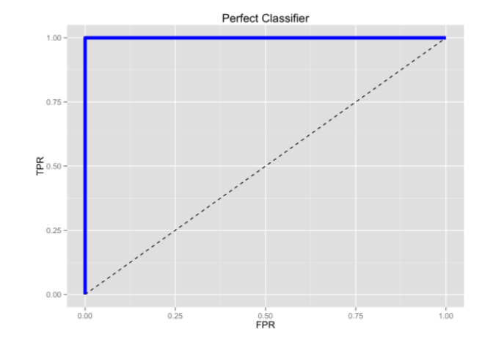
Model Bias
Bias From Missed Labels in Training Data
Often when training a model you’re data is not perfect (far from it)
you’re often not certain that you have all the labels labelled
you’re also often biased to the way in which you labelled you’re data, and this results in only training you’re model on certain types of labels
You need to be conscientious of this when training, and particularly evaluating a model
Ways to help check this are to look at how your model is ranking never before seen data
Bias From Overfitting to Training Data
This is common in NLP, as you can end up with many specific keywords in some of your labels, to the point where your model classifies into a given category every time this keyword is present
Even if you’re performing well on the testing set, this does not ensure your model will perform well on new data in production
Checking for Model Bias
Performance much better than expected
When interpreting how the model is working check whether using elements of the input that won’t allow it to effectively generalize
Does not perform well or intuitively on never before seen data
For NLP this can be tested by seeing what the highest ranking predictions are on some brand new text data
When dealing with time series data you always want to see how your model performs in future time periods
Separate from those used to train the model on
https://fderyckel.github.io/2017-03-15-Logistic_Regression_Part_I/

Slide 3
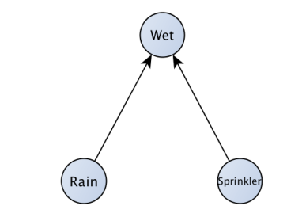
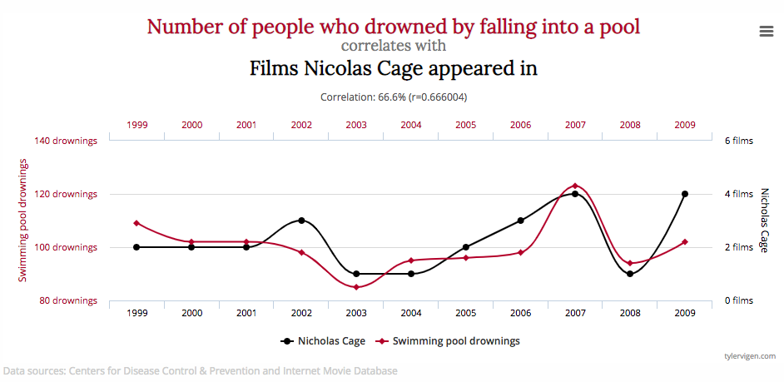
Model Bias (Cont.)
Bias From Conditioning
You also want to be careful about whether you’re conditioning on anything in your training data, when such conditioning isn’t present in production
As conditioning can result in relationships that appear to be there when in reality they’re not
For example consider the following system:
You’re trying to predict whether it rained or not using some images that have been collected
You have an image of a sidewalk in front of a house, and sprinkler on the grass in front of the house
You notice that in all your pictures the sidewalk looks to be wet
Is this a problem?
Yes, because when you deploy this model the sidewalk won’t always be wet
How will this cause a problem?
You’re model will learn that the sprinkler being on reduces the chances of rain
Because in it’s data it does
This occurs any time you have 2 features that are causing something, and you condition on what they’re causing and then try to model the relationship between these 2 features
Bias from confounding
Time series are particularly bad for confounding variables
As 2 time series that are serially correlated with themselves have an increased chance of being correlated with each other as well
Be sure to test in different time periods to make sure relationships hold
https://medium.com/causal-data-science/understanding-bias-a-pre-requisite-for-trustworthy-results-ee590b75b1be
http://www.tylervigen.com/spurious-correlations

